Slide 1
Latent Semantic Analysis SVD, LDA
Chien Chin Chen

Slide 2
Term Grouping and Why
Now, we know how to do document clustering. How about grouping terms into clusters?
Each cluster would represent a certain concept or TOPIC!!
For instance, cell, android, and iphone are all about mobile phone.
Term clustering makes semantic search possible.
Search engines search for document based on their meaning, rather than keyword matching.
For instance, users search for “iphone” and “12 pro” would obtain the same result.
Identifying terms with similar meaning is a challenging text mining research topic, called latent semantic analysis (LSA).
Here, we present two well-known LSA methods: singular value decomposition and latent Dirichlet allocation.

Slide 3
Latent Semantic Analysis Benefits A LOTS
LSA helps represent each document as a topic vector.
Successfully reduce the dimensionality of document.
Benefits of such dimension reduction:
Enhance the similarity calculation of documents that further bring out better classification/clustering performance.
Cosine similarity (Euclidean distance) based on sparse TFIDF/frequency vectors would be messed up.
Reduce storage requirement and facilitate model learning and testing.
apple | 0.04
iphone | 0.16
party | 0.01
… | …
x’max | 0.01
classmate | 0.03
Last night, I used my apple iphone …
topic₁ | 0.05
topic₂ | 0.27
… | …
topic₁₀ | 0.17

Slide 4
Remember Token Normalization?
Stemming and lemmatization also help similarity calculation by grouping terms superficially different together.
Manufacture, manufacturing, manufactured, manufactured
Operator, operation, operate
LSA take token normalization to another level by handling synonyms.
Cell, phone, mobile → the same topic

Slide 5
Singular Value Decomposition (1/6)
One popular method of latent semantic analysis is Singular Value Decomposition (SVD).
SVD is not a new technology; you can find it in every linear algebra textbook.
Actually, it was heavily used in the field of data mining to reduce the dimensions of data.
We first talk about the math of SVD, and then apply it to latent semantic analysis.

Slide 6
Singular Value Decomposition (2/6)
Mathematically, SVD decomposes a (any) matrix B into three matrices.
B = U Σ V^{T}
B_{mxn}
U_{mxm}
Σ_{mxn}
V^{T}_{nxn}
=

Slide 7
Singular Value Decomposition (3/6)
The columns in U and V are left and right singular vectors respectively.
Which are also the eigenvectors of BB^{T} and B^{T}B, respectively.
In terms of text corpus, these singular vectors form the basis of retaining term-term/document-document relation.
Or the topics in terms of terms and documents
topics
documents
U_{mxm}
V^{T}_{nxn}
topic₁
topic₂
topics
terms
topic₁
topic₂

Slide 8
Singular Value Decomposition (4/6)
The matrix Σ is a diagonal matrix.
The diagonal entries are singular values of B, and they are non-negative!!
Usually, the diagonal elements are arranged in descending order.
They tell how much each singular vector contributes in restoring the matrix B.
0
≥0
0
Σ_{mxn}

Slide 9
Singular Value Decomposition (5/6)
Restoring B and dimension reduction:
B can be approximated by preserving k significant singular values and the corresponding singular vectors.
k << m, n
B_{mxn}
=
≈
V^{T}_{kxn}
V^{T}_{nxn}
U_{mxk}
U_{mxm}
Σ_{kxk}
Σ_{mxn}

Slide 10
Singular Value Decomposition (6/6)
Back to the term-document matrix
By preserving k most significant topics, we may re-construct the original text!! (without losing too much text information)
documents
k topics
documents
B_{mxn}
k topics
≈
terms
terms
V^{T}_{kxn}
U_{mxk}
Σ_{kxk}
This way, a document can be represented by a k-dimensional (low) vector.

Slide 11
SVD + KNN Example (1/6)
In our previous examples, we input classification and clustering models sparse TFIDF vectors.
In this practice, we first convert documents into low-dimensional topic vectors using SVD.
Then, using them to construct a KNN classification model.

Slide 12
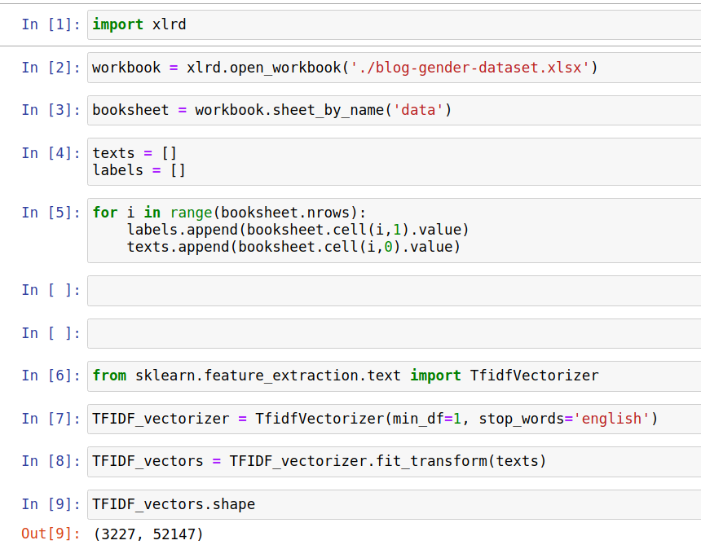
SVD + KNN Example (2/6)
Nothing new here; just create the TFIDF matrix (vectors)

Slide 13
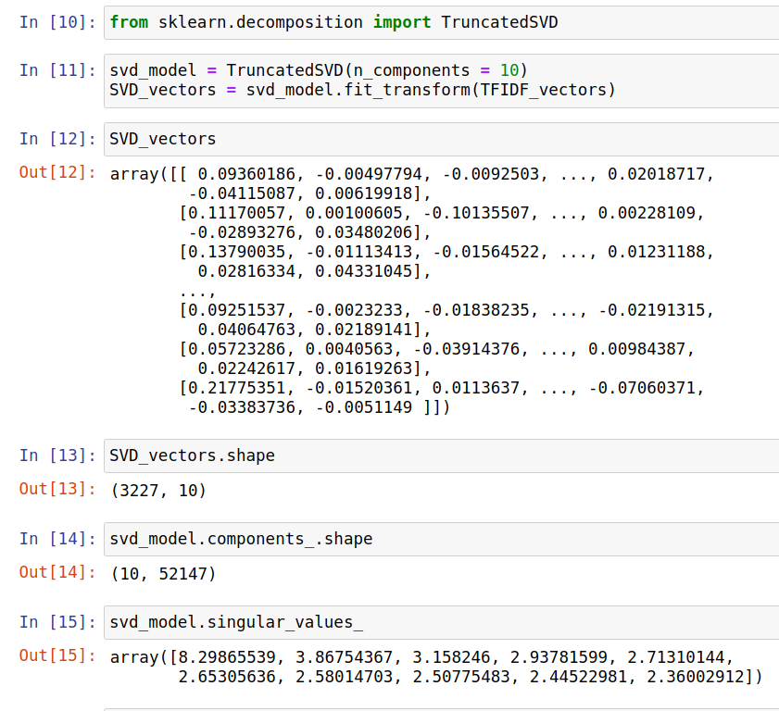
SVD + KNN Example (3/6)
10x3227
TF
IDF
≈
10x10
52147x3227
52147x10

Slide 14
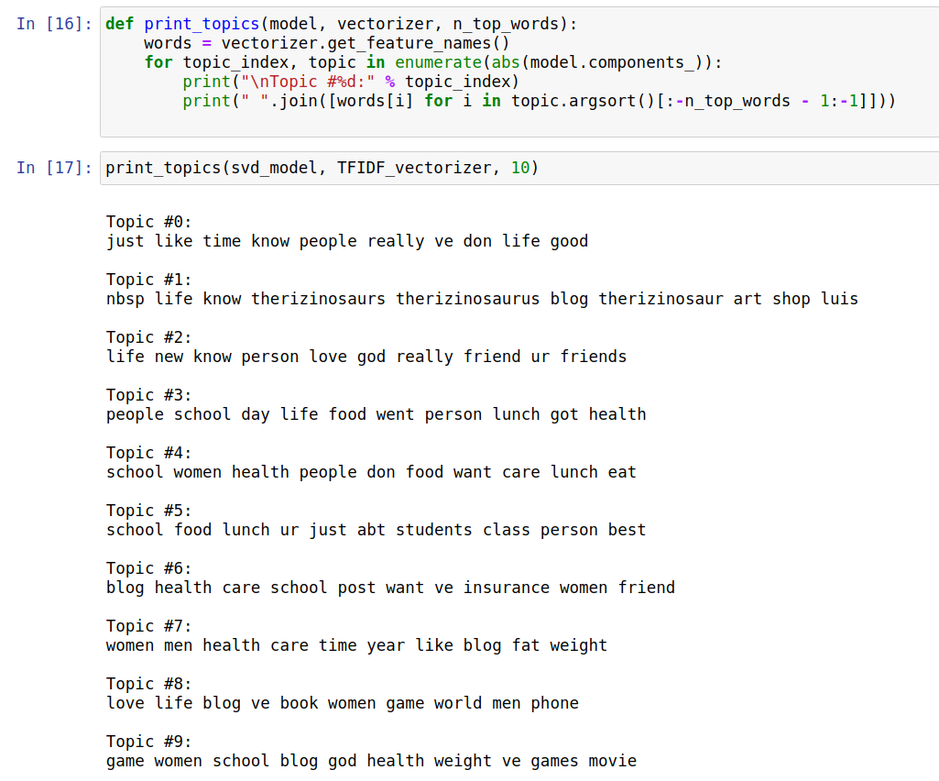
SVD + KNN Example (4/6)

Slide 15
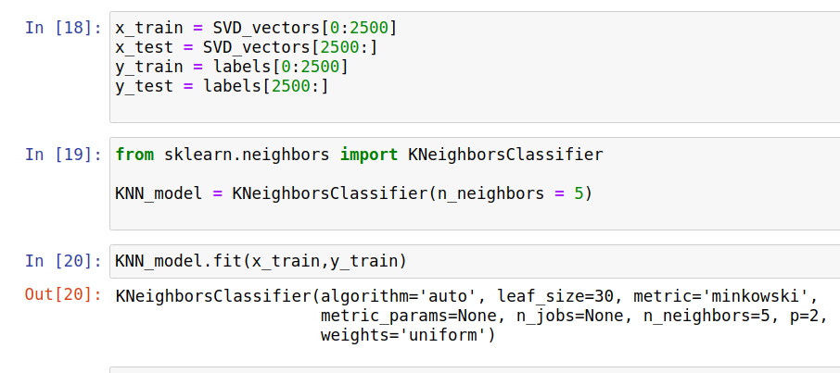
SVD + KNN Example (5/6)
Train/testing documents now are represented as topic vectors!!

Slide 16
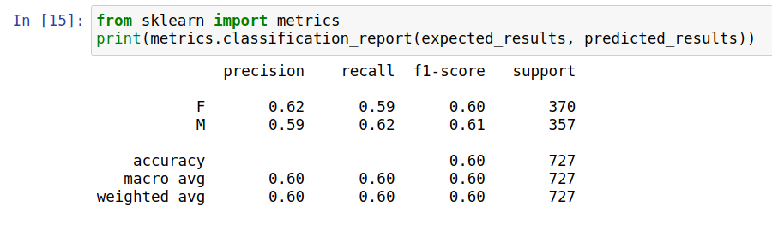
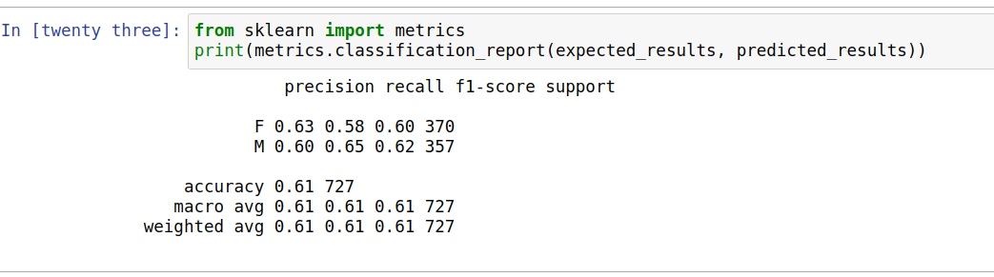
SVD + KNN Example (6/6)
TF-IDF
SVD
Dimension reduction: from 52147 to 10 !!

Slide 17
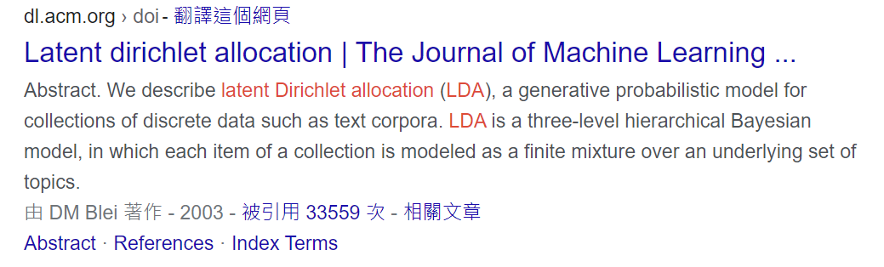
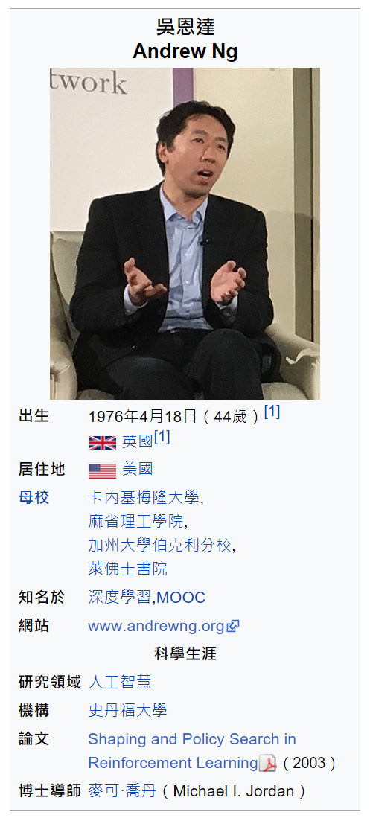
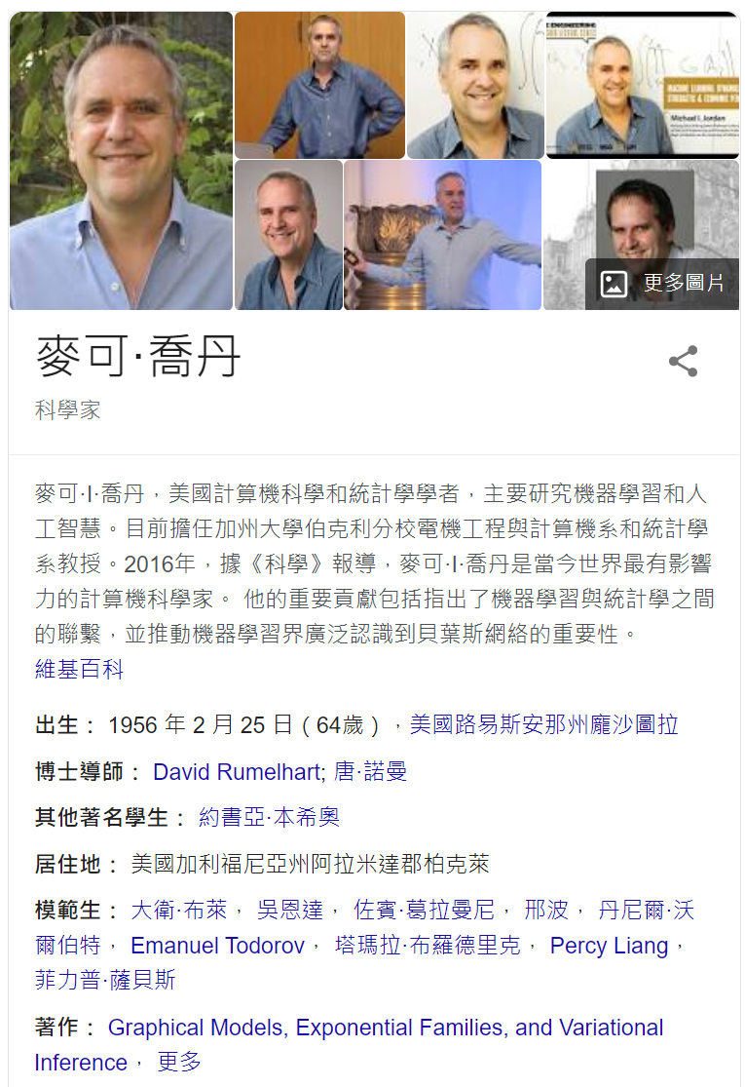
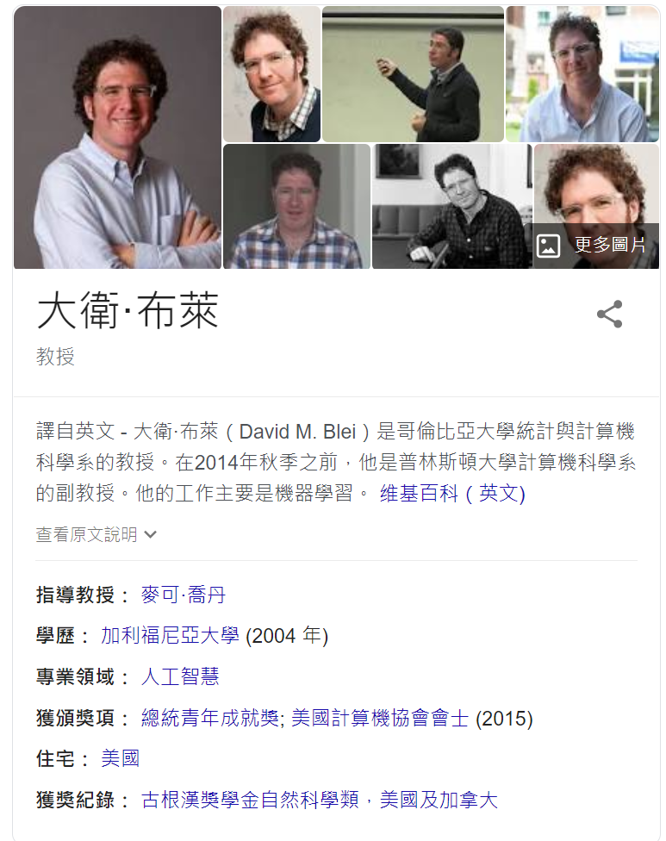
Latent Dirichlet Allocation (1/13)
A probability-based topic discovery model.
Reference paper: David M. Blei, Andrew Y. Ng, and Michael I. Jordan, Latent Dirichlet Allocation, Journal of Machine Learning Research, 3 (2003), 993-1022.

Slide 18
Latent Dirichlet Allocation (2/13)
Concept/assumption:
A document is generally involved several topics.
LDA views each document as a random mixture over latent topics.
Or … each document is with a topic distribution.
Different topics prefer different words.
LDA characterizes a topic by a distribution over words.
Or … each topic is with a word distribution.
When composing a document, LDA assumes:
A topic is selected based on the document’s topic mixture.
Then, a word is emitted in accordance with the topic’s word distribution.
The two sets of distributions are unobserved!!
We would like to infer them from a text corpus.

Slide 19

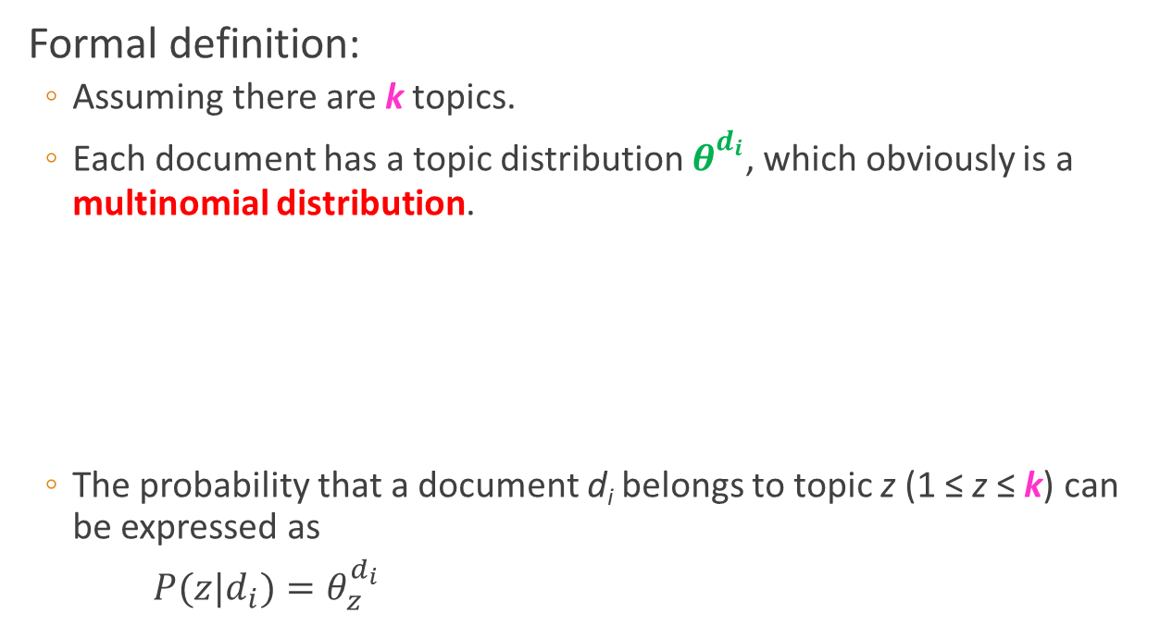


Latent Dirichlet Allocation (3/13)
Pre-defined!!
Formal definition:
Assuming there are k topics.
Each document has a topic distribution $θ_{}^{d_{i}}$, which obviously is a multinomial distribution.
The probability that a document d_{i} belongs to topic z (1 ≤ z ≤ k) can be expressed as
$P(z|d_{i})=θ_{z}^{d_{i}}$
$$θ_{}^{d_{1}}$$
$$θ_{}^{d_{2}}$$
$$θ_{}^{d_{N}}$$
…
1 2 3 … k
1 2 3 … k
1 2 3 … k
This distribution, usually represented as a k-dimensional vector, is what the task of dimension reduction wants.

Slide 20

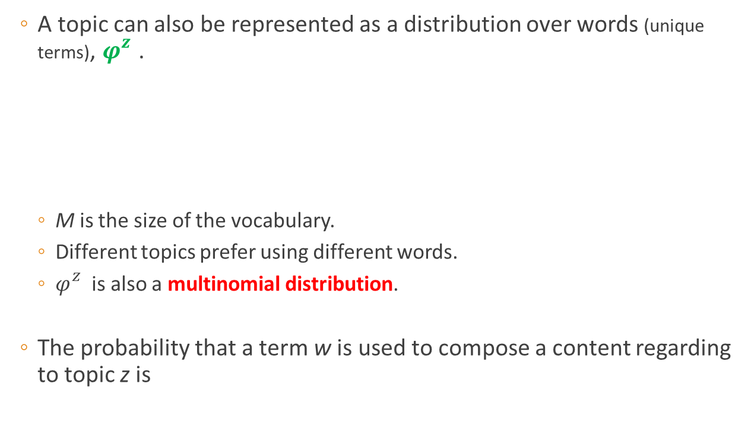



Latent Dirichlet Allocation (4/13)
A topic can also be represented as a distribution over words (unique terms), $φ_{}^{z}$.
M is the size of the vocabulary.
Different topics prefer using different words.
$φ_{}^{z}$is also a multinomial distribution.
The probability that a term w is used to compose a content regarding to topic z is
$$φ_{}^{1}$$
$$φ_{}^{2}$$
$$φ_{}^{k}$$
…
1 2 3 … M
1 2 3 … M
1 2 3 … M
$$P(w|z)=φ_{w}^{z}$$

Slide 21


Latent Dirichlet Allocation (5/13)
Based on the above distributions, the probability of seeing a word w in document d_{i} is expressed as:
$P(w|d_{i})=\sum_{z=1}^{k}{P\left(z | d_{i}\right)P\left(w | z\right)}=\sum_{z=1}^{k}{θ_{z}^{d_{i}}φ_{w}^{z}}$
A graphical model representation of LDA:
Two Dirichlet hyper-parameters
α and β are added into the model.
Good … but … where is Dirichlet?
β
$$φ$$
k
What are those?
α
θ
z
w
N

Slide 22


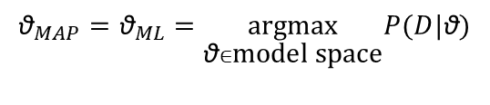
Latent Dirichlet Allocation (6/13)
To understand the role of the two Dirichlet hyper-parameters, we have to talk about maximum a posteriori (MAP) estimate.
Track back to the model-based clustering.
To simplify the model search problem, we generally assume that the prior probability of every model is equal (e.g., P(θ_{i}) = P(θ_{j}) for all i and j in the model space).
Then…
$${\text{θ}}_{MAP}=\underset{\text{θ}∈\text{model} \text{space}}{argmax}P(\text{θ}|D)$$
What if the prior is not uniform??
Can we incorporate our prior beliefs into the
parameter estimate process?
$$=\underset{\text{θ}∈\text{model} \text{space}}{argmax}\frac{P(D|\text{θ})P(\text{θ})}{P(D)} \\ =\underset{\text{θ}∈\text{model} \text{space}}{argmax}P(D|\text{θ})P(\text{θ})$$
$${\text{θ}}_{MAP}={\text{θ}}_{ML}=\underset{\text{θ}∈\text{model} \text{space}}{argmax}P(D|\text{θ})$$

Slide 23
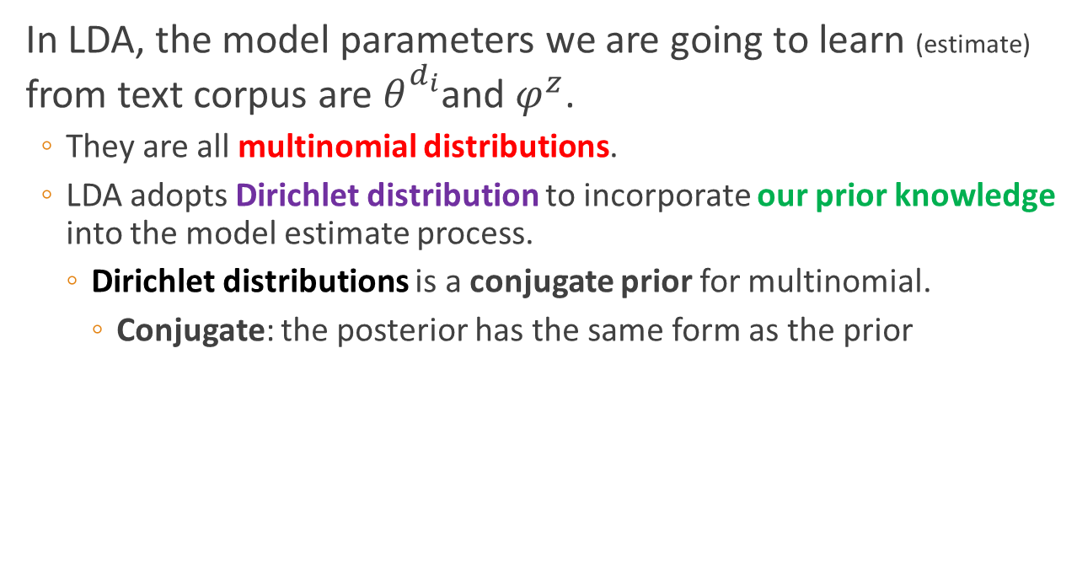
Latent Dirichlet Allocation (7/13)
In LDA, the model parameters we are going to learn (estimate) from text corpus are $θ_{}^{d_{i}}$and $φ^{z}$.
They are all multinomial distributions.
LDA adopts Dirichlet distribution to incorporate our prior knowledge into the model estimate process.
Dirichlet distributions is a conjugate prior for multinomial.
Conjugate: the posterior has the same form as the prior

Slide 24
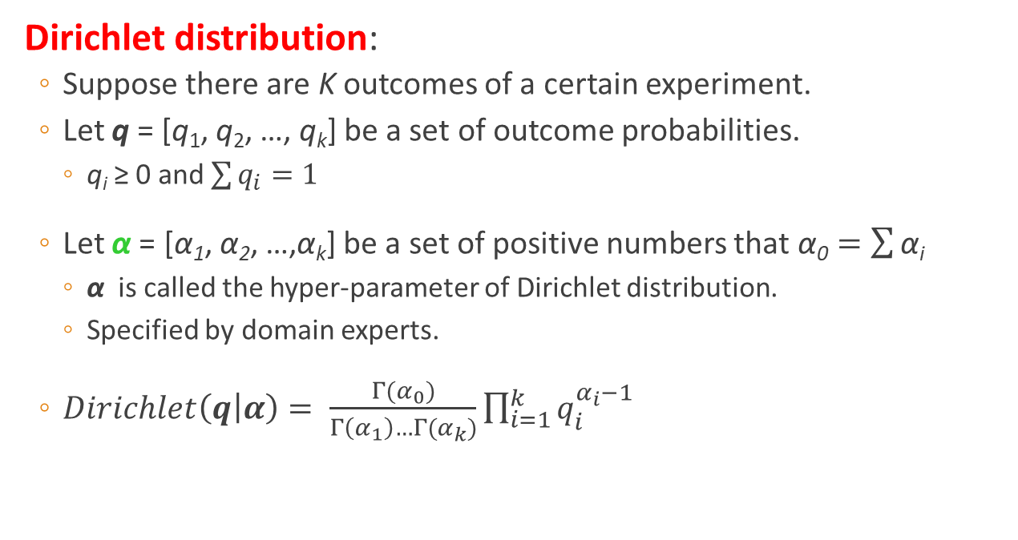
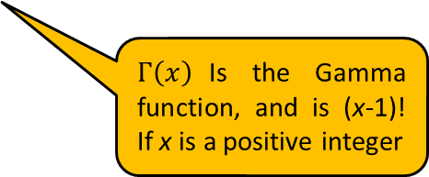
Latent Dirichlet Allocation (8/13)
Dirichlet distribution:
Suppose there are K outcomes of a certain experiment.
Let q = [q₁, q₂, …, q_{k}] be a set of outcome probabilities.
q_{i} ≥ 0 and $\sum{q_{i}}=1$
Let α = [α₁, α₂, …,α_{k}] be a set of positive numbers that $\text{α}\text{0}=\sum{\text{α}\text{i}}$
α is called the hyper-parameter of Dirichlet distribution.
Specified by domain experts.
$Dirichlet\left(q | α\right)= \frac{Γ(α_{0})}{Γ\left(α_{1}\right)…Γ(α_{k})}\prod_{i=1}^{k}{q_{i}^{α_{i}−1}}$
Very similar to
multinomial distribution?
$Γ\left(x\right)$Is the Gamma function, and is (x-1)! If x is a positive integer

Slide 25
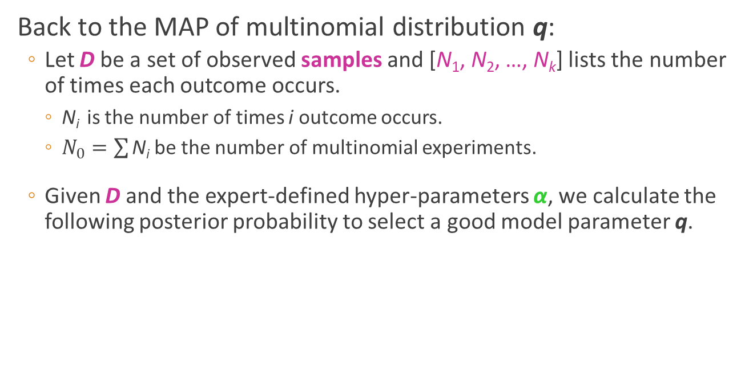
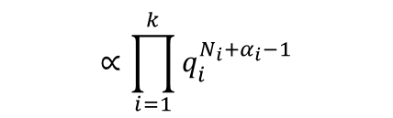
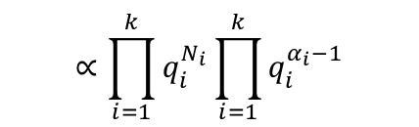

Latent Dirichlet Allocation (9/13)
Back to the MAP of multinomial distribution q:
Let D be a set of observed samples and [N₁, N₂, …, N_{k}] lists the number of times each outcome occurs.
$\text{N}\text{i}$ is the number of times i outcome occurs.
$N_{0}=\sum{\text{N}\text{i}}$ be the number of multinomial experiments.
Given D and the expert-defined hyper-parameters α, we calculate the following posterior probability to select a good model parameter q.
$$P(q|D)∝P(D|q)P(q)$$
$$∝\prod_{i=1}^{k}{q_{i}^{N_{i}}}\prod_{i=1}^{k}{q_{i}^{α_{i}−1}}$$
$$∝\prod_{i=1}^{k}{q_{i}^{N_{i}+α_{i}−1}}$$

Slide 26


Latent Dirichlet Allocation (10/13)
The equation helps interpret the role of the hyper-parameters in the model estimate process.
The posterior of q is calculated by combining two datasets.
One is the observed sample D (i.e., [N₁, N₂, …, N_{k}]).
The other one is an imaginary dataset originated from our prior beliefs (i.e., α = [α₁, α₂, …,α_{k}]).
Larger α implies we have a higher confidence in our prior beliefs.
$$P(q|D)∝P(D|q)P(q)$$
$$∝\prod_{i=1}^{k}{q_{i}^{N_{i}+α_{i}−1}}$$

Slide 27

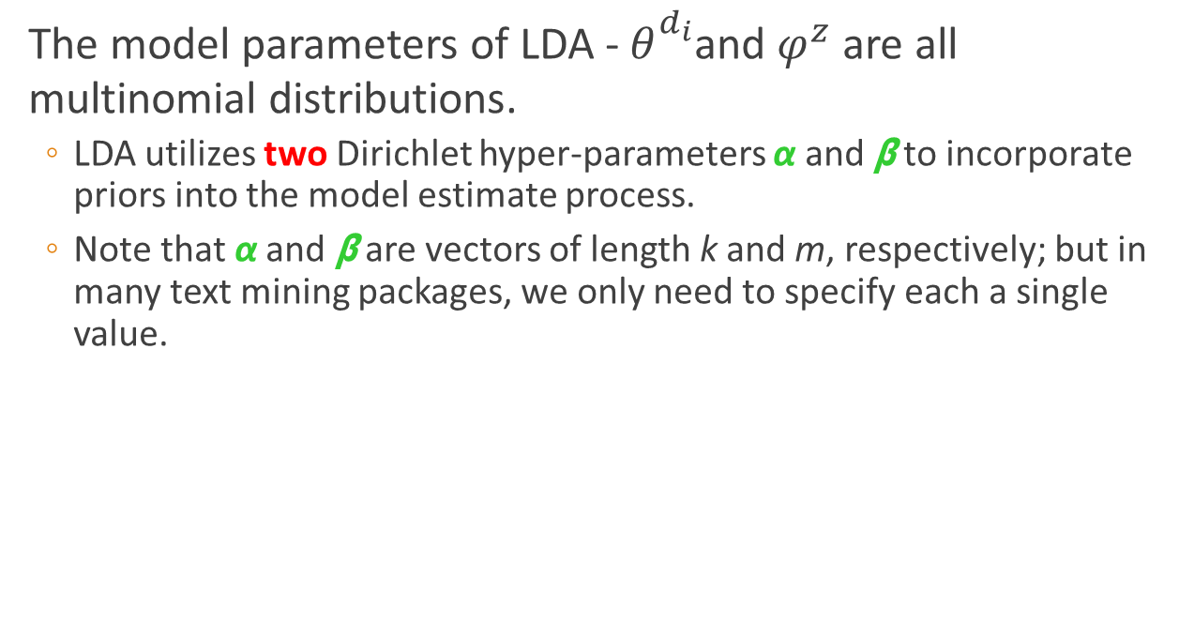
Latent Dirichlet Allocation (11/13)
The model parameters of LDA -$θ_{}^{d_{i}}$and $φ^{z}$ are all multinomial distributions.
LDA utilizes two Dirichlet hyper-parameters α and β to incorporate priors into the model estimate process.
Note that α and β are vectors of length k and m, respectively; but in many text mining packages, we only need to specify each a single value.
β
$$φ$$
k
α
θ
z
w
N

Slide 28
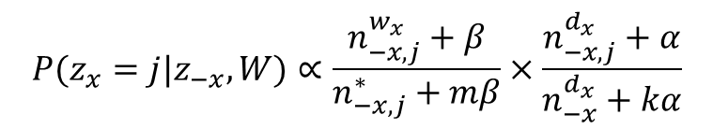
Latent Dirichlet Allocation (12/13)
LDA’s parameter inference is complicated. One frequently used inference approach is based on Gibbs sampling:
First randomly assign each word in the text corpus an integer in [1, k].
That is, to randomly assign a topic to each word.
Then, sequentially examine the words and compute the following probability.
Use the above topic distribution to sample a topic for the current word.
$$P(z_{x}=j|z_{−x},W)∝\frac{n_{−x,j}^{w_{x}}+β}{n_{−x,j}^{∗}+mβ}×\frac{n_{−x,j}^{d_{x}}+α}{n_{−x}^{d_{x}}+kα}$$

Slide 29

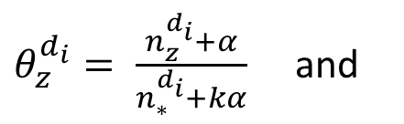
Latent Dirichlet Allocation (13/13)
With a sufficient number of sampling, model parameters are estimated as follows:
No worry too much, packages help you acquire the distribution with a few lines of code.
So …. Let’s practice
$θ_{z}^{d_{i}}= \frac{n_{z}^{d_{i}}+α}{n_{∗}^{d_{i}}+kα}$ and
$$φ_{w}^{z}=\frac{n_{z}^{w}+β}{n_{z}^{∗}+mβ}$$
This way, you represent a document as a k-dimensional vector.
The distribution would reveal what a topic is.

Slide 30
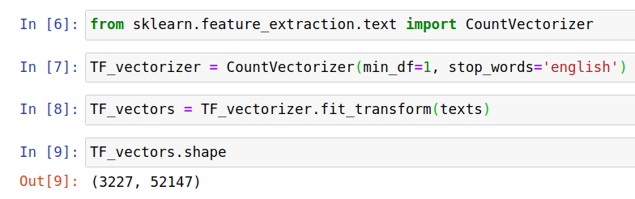
LDA + KNN Example (1/4)
LDA is based on multinomial distribution, and the input of LatentDirichletAllocation needs to be frequency vectors.

Slide 31
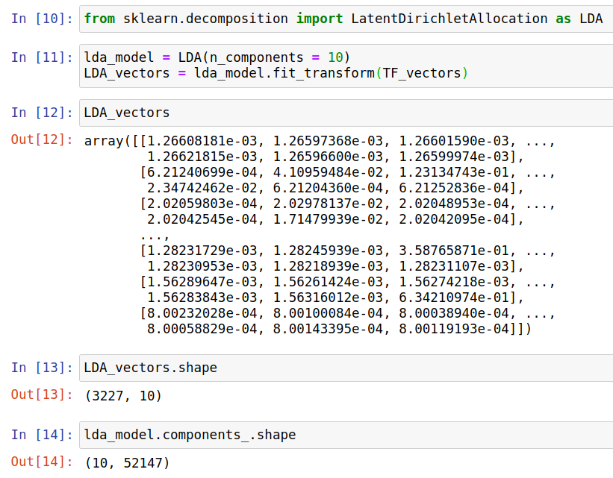
LDA + KNN Example (2/4)
You can specify α and β using parameters doc_topic_prior and word_topic_prior.
The default value of them is 1/n_components

Slide 32
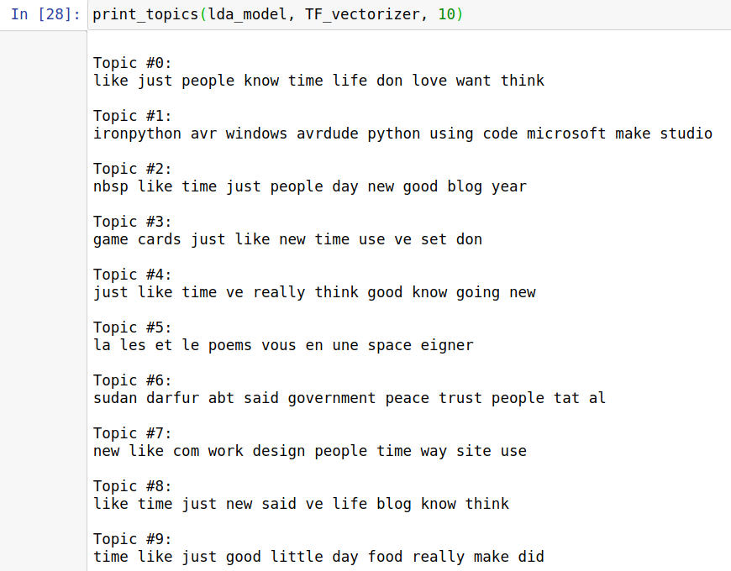
LDA + KNN Example (3/4)

Slide 33
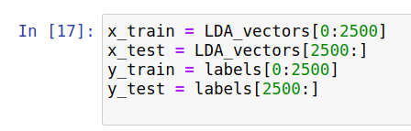
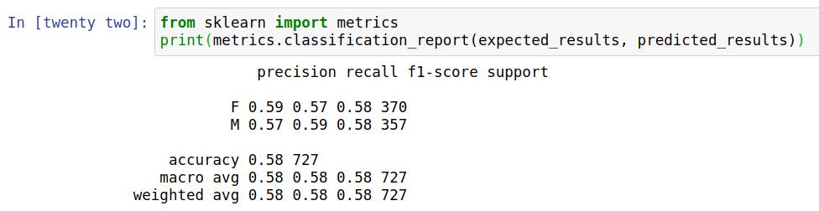
LDA + KNN Example (4/4)

Slide 34
Summary
Now, we are able to extract topics from documents and represent each document/term by a topic vector!!
Is that good enough?? How about POLYsemy??
I walked into a bank aside a river bank.
SVD and LDA use a single topic vector for these two ‘bank’, even though their meanings are totally different!!
Polysemy may overestimate the similarity between documents.
Can we determine the meaning of a word according to its context??
Here comes BERT!!!!!

